Slide 1
GROUP 1 ROBOTICS PROJECT
Jimmy Kong, Jalen Smith, Jared Mishen

Slide 2
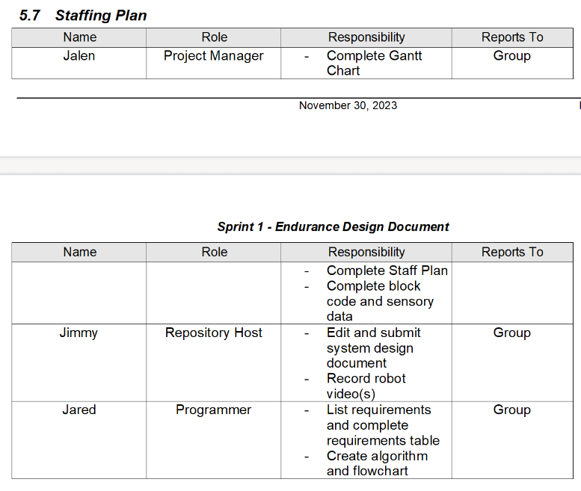
Our Team and Roles
Jalen – Program creator and Robot tester
Jared – flowchart creator and algorithm writer
Jimmy – Design document editor and video recorder

Slide 3
Challenges Faced
Time management - In the start having to divide time between other school assignments and meeting in one area seemed difficult (Over time we were able to figure it out)
Collaboration in the early stages - Understanding the different roles and playing towards our strengths and weaknesses. For example, Jared being good with the Algorithm/Flowcharts, Jalen being good with the robot code, and Jimmy being great at organizing ideas and getting pen to paper
Critical thinking of the sprints - Understanding and following all key parts of the robot programs, especially Sprint 2 (Using the roll feature and requiring a lot of group activity in order to perfect the sprint/data diagram).
Organization of Ideas and specific details - Related to the critical aspect portion of our Project, but really having to document everything in our Gantt chart/task plan and test cases.

Slide 4
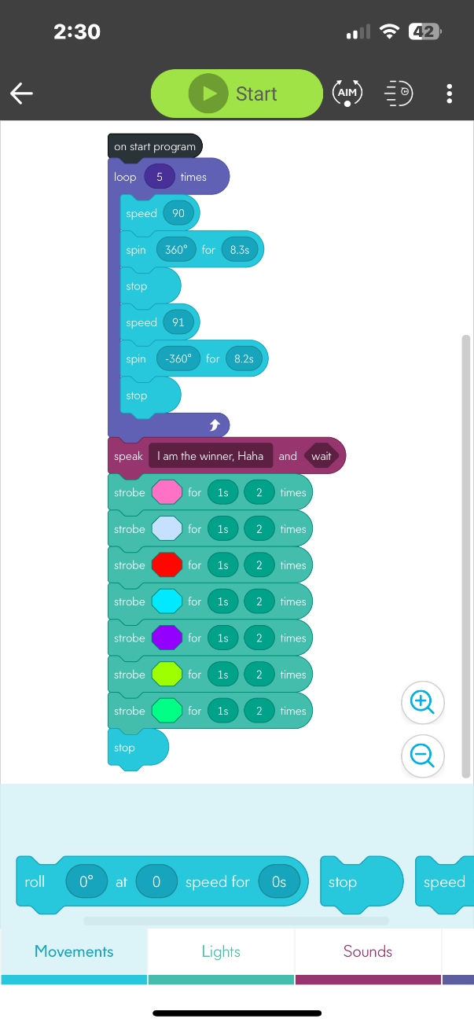
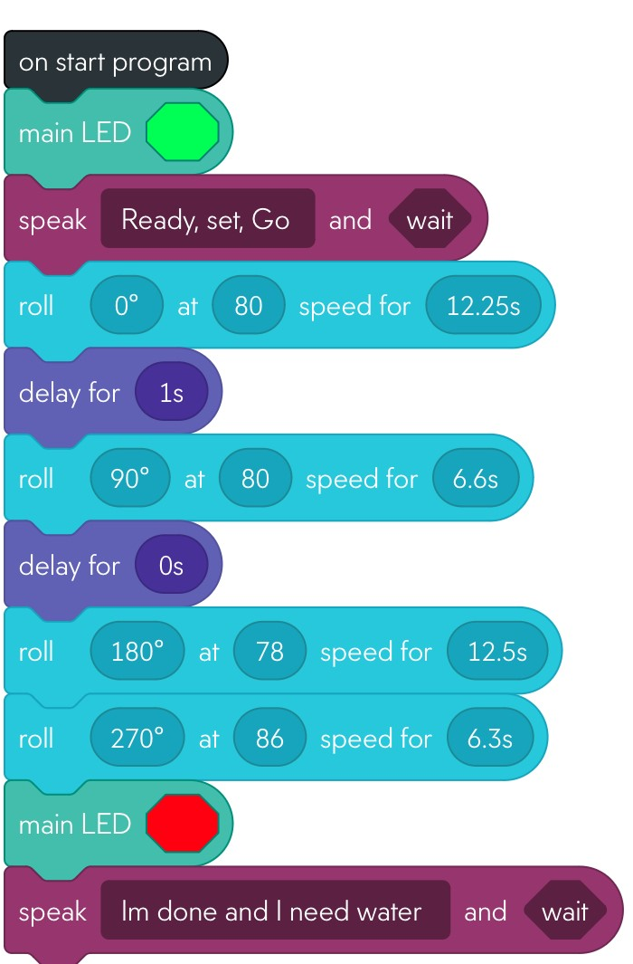
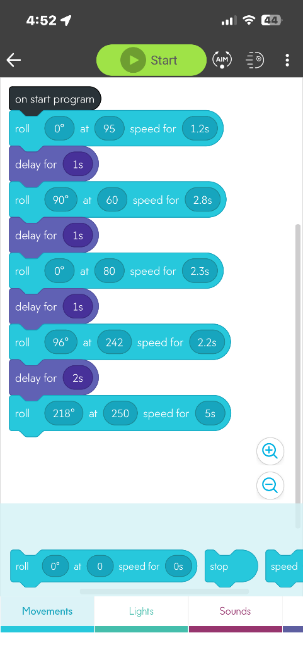
Block Codes used in the project
Sprint #1 (Endurance)
Sprint #3 (Agility)
Sprint #2 (Accuracy)

Slide 5
Sprint #3 (Agility) Results
Robot video 3 (Agility): https://www.youtube.com/shorts/Yi_tTTLEbeQ
Sprint #3 (Agility) block code

Slide 6
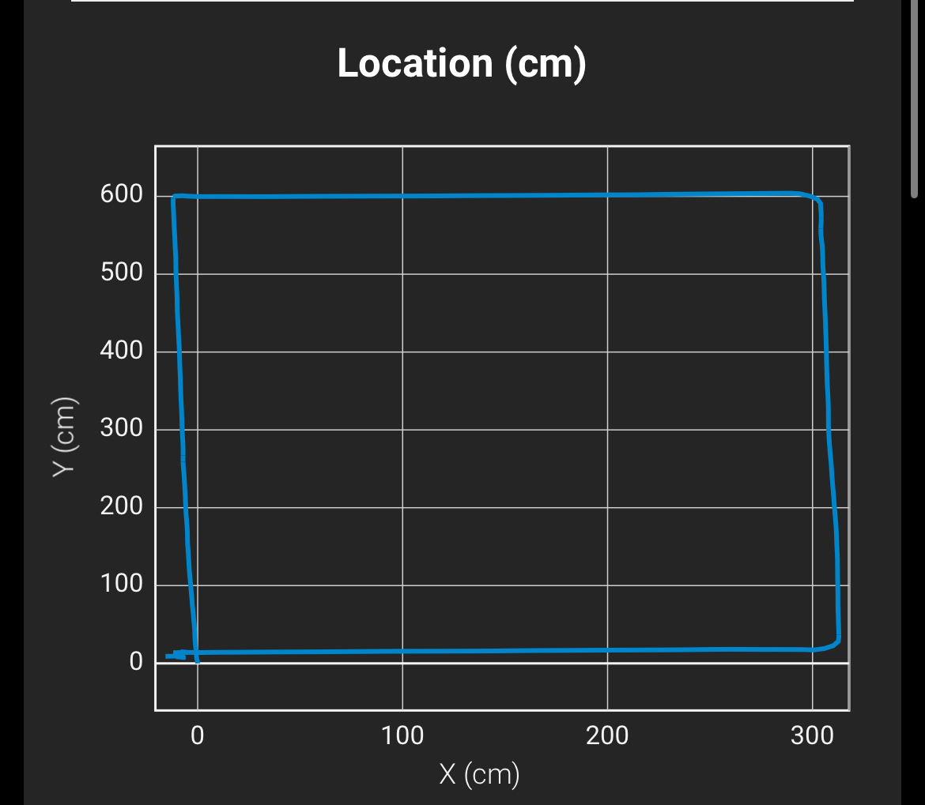
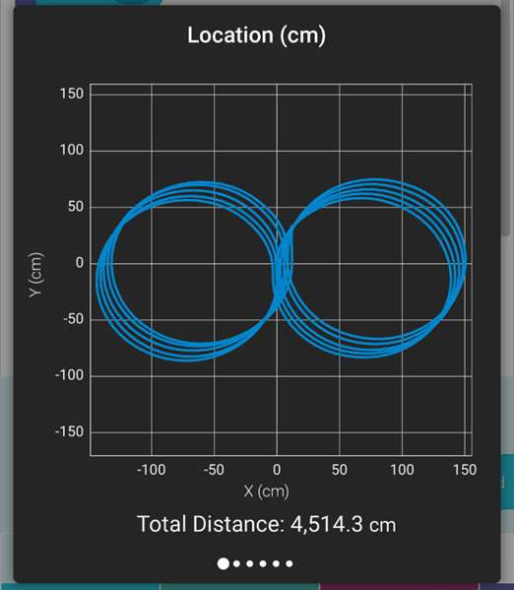
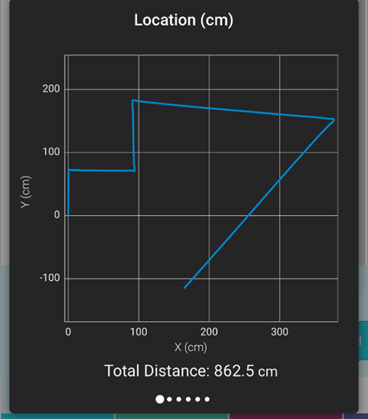
Triathlon Performance (videos)
Endurance (Sprint #1) video link - https://youtube.com/shorts/m8vFu25HrPQ
Accuracy (Sprint #2) video link - https://youtu.be/BnNO4Vc0ITo
Agility (Sprint #3) video link - https://youtube.com/shorts/Yi_tTTLEbeQ

Slide 7
Lessons Learned about Software Engineering
Running each program successfully takes multiple times, not once or twice; reporting flaws in the code helps to remedy them
The System Design Document explains the purpose of the project and includes detailed information about computers used, the people involved, and other conditions of the project
Requirements in the SDD must be different for every sprint and specified uniquely (rather than being general about the whole project)
Each group member must have evidence of their completion of the project (in this case, each of us had to commit at least one item to the GitHub repository)

Slide 8
What we could have done differently
As mentioned in the previous slide, we were initially unaware that every group member was required to commit at least one item (file, URL, etc.) to the Github repository
Including a description to each commit would have made it easier to navigate which item in the repository was which (video link, SDD, Gantt chart, flowchart)
We should have taken note about the floor where we experimented the robot with our code; that way, the measurements in the code guiding the robot would have traversed the course more accurately

